Slide 1

CompSci 471
Artificial Intelligence
Lesson 28: Neural Networks I
b = 0
Stack simple neurons, get complex shapes.
x₁
3
h₁ ReLU
1
1
−1
1.5
out σ
0.88
−2
2
x₂
1
h₂ ReLU
0
b = 0.5
1
Weigh
Sum
Activate
Stack
b = 1
Two inputs in, one prediction out.
Fall 2026
Notes:
TIMING: 1 min (slides 1-3 total 4 min).
INSTRUCTOR: The graphic is a complete neural network: two inputs on the left, two hidden neurons, one output. Every circle holds a number and every line holds a weight (blue positive, orange negative). By slide 15 students will have computed every value shown here by hand, including the 0.88 output. Point out the hidden neuron holding 0: it "switched off" for this input, and understanding why is a key idea today.
The four stage labels (Weigh, Sum, Activate, Stack) are the lesson's storyline.
CENTRAL CLAIM: A neuron is a weighted vote followed by a squash, and a single neuron is just L26's logistic regression. Stacking neurons with non-linear activations lets a network bend its boundary and build its own features; without that non-linearity, any stack collapses back to a straight line.
ASSESSMENT ALIGNMENT: Framing only. [Confirm lesson placement and assessment timing against the syllabus when available.]

Slide 2
Retrieval: so far, we chose the shape
We chose the shape; the model chose the numbers.
L26 | Logistic regression
L26 | Model gallery
L26 | Kernel trick
Weighted score z, then sigmoid, then threshold.
Lines, simple curves, rectangles.
When a line failed, we hand-built x².
One straight boundary.
We picked the shape.
We picked the feature.
What if the model could learn its own features?
Turn and talk (45 s): which L26 model could wrap a boundary around a cluster, and how?
CS 471 | L28: Neural Networks I
2
Notes:
TIMING: 1.5 min.
INSTRUCTOR: Recall three things from L26. (1) Logistic regression computed a weighted score z, squashed it with a sigmoid, and applied a threshold. Students will see that exact pipeline again in a few minutes, renamed "a neuron." (2) Every model in the L26 gallery drew a boundary shape we picked in advance by picking the model: lines, simple curves, rectangles. (3) When the data needed a shape the model could not draw, we hand-built a new feature (x-squared in the kernel slide).
Neural networks change the division of labor: the network learns useful intermediate features itself.
Turn-and-talk answers: QDA (curved boundary from per-class spreads) or a kernel SVM; both rely on a shape or transformation that we chose.
ASSESSMENT ALIGNMENT: Retrieval for Objectives 1 and 3. [Confirm against GR/quiz items when available.]

Slide 3
Today’s mission
By the end of Lesson 28, you should be able to…
1
Describe an artificial neuron (inputs, weights, bias, activation) and compute its output from the weighted sum.
2
Execute forward propagation through a small feedforward network, tracking the value at every node.
3
Explain why non-linear activations are required, and how hidden layers and multiple outputs let a network bend boundaries and share learned features.
Performance target: given a small network’s weights and an input, compute every node’s value and the output, and explain what changes if the activations were linear.
CS 471 | L28: Neural Networks I
3
Notes:
TIMING: 1.5 min.
INSTRUCTOR: Objective 1 = Part 1 (single neuron). Objective 2 = Part 2 (forward propagation). Objective 3 = Parts 3 and 4 (non-linearity, hidden features, multiple outputs). Point to the performance target: students do it on slide 16 and the exit ticket.
Tell students up front: today the weights are GIVEN. How a network learns its weights is next lesson's topic.
DESIGN NOTE: The source listed four objectives; "compute weighted sums" is folded into Objectives 1 and 2 because students compute a weighted sum on nearly every slide.
ASSESSMENT ALIGNMENT: Knowledge Check Q2 (weight vs. bias) = Objective 1; Q4 (ReLU on a negative sum) = Objective 2; Q1 (linear stacking) and Q3 (multiple outputs) = Objective 3. [Map to specific GR, quiz, Blackboard homework, and notebook items when available.]

Slide 4
Running scenario: keep the servers healthy
A cloud team wants early warnings from its server metrics.
server-07 | live metrics
Q1 | Part 1
Will this server crash in the next hour?
CPU load
0.9 (90%)
Q2 | Part 3
Memory used
0.7 (70%)
Is CPU load abnormal: too low (hung service) or too high (overload)?
Requests / sec
3 (300 / s)
Prediction: can one neuron answer Q2?
CS 471 | L28: Neural Networks I
4
Notes:
TIMING: 1.5 min (Part 1 total 13 min).
INSTRUCTOR: Introduce the dashboard. Three live metrics per server: CPU load (fraction of capacity, 0 to 1), memory used (fraction, 0 to 1), and requests per second (in hundreds). Two questions will run through the lesson:
Q1 (Part 1): Will this server crash in the next hour? The riskier every metric looks, the higher the risk, so one neuron (one straight boundary) handles it.
Q2 (Part 3): Is CPU load abnormal? CPU near 0 means a hung or dead service; CPU near 100% means overload; the middle is healthy. Alerts at BOTH ends. Ask students to predict now whether one neuron can handle Q2; resolve on slide 17.
ASSESSMENT ALIGNMENT: Context for Objectives 1 and 3. [Confirm against GR/quiz items when available.]

Slide 5
From biology to math
Inspiration, not simulation.
Biological neuron | Artificial neuron | Symbol
Dendrites receive signals | Inputs | x₁, x₂, …
Connection strength | Weights | w₁, w₂, …
Firing threshold | Bias | b
Fires or stays quiet | Activation function | f(z)
Caution
Real neurons involve timing, chemistry, and feedback. The artificial neuron keeps only the skeleton: weigh, sum, decide.
A neuron is a weighted vote followed by a decision.
CS 471 | L28: Neural Networks I
5
Notes:
TIMING: 1.5 min.
INSTRUCTOR: A biological neuron collects signals through its dendrites; connections differ in strength; if the combined signal passes a threshold, the neuron fires. The artificial neuron keeps only that skeleton: inputs, weights for connection strength, a bias that shifts the threshold, and an activation function that decides the output.
Caution students: real neurons are vastly more complex (timing, chemistry, feedback). "Neural" is a naming inspiration; nobody should conclude these models think like brains.
HISTORY (optional, 20 s): Rosenblatt's perceptron (1958) used a hard step function: fire (1) or not (0). Modern networks use smooth or piecewise-linear activations such as sigmoid and ReLU, which later make training possible.
ASSESSMENT ALIGNMENT: Objective 1 (neuron components). [Confirm against GR/quiz items when available.]

Slide 6
Anatomy of an artificial neuron
Weigh each input, add them up, shift by the bias, then activate.
x₁
w₁
x₂
Σ wᵢxᵢ
sum
+ b
b
z
z
f
output
a
w₂
w₃
x₃
z = Σ wᵢxᵢ + b
a = f(z)
Weight
Bias
Belongs to one input: how much it matters, and in which direction.
Belongs to the neuron: its default leaning when every input is 0.
CS 471 | L28: Neural Networks I
6
Notes:
TIMING: 2 min.
INSTRUCTOR: Trace the diagram left to right. Each input is multiplied by its weight (line thickness = size of weight; blue = positive, orange = negative). The products are summed, the bias is added, giving z. The activation function f turns z into the neuron's output a.
WEIGHT vs. BIAS (Knowledge Check Q2): a weight belongs to one input and says how much that input matters and in which direction. The bias belongs to the neuron itself; it is the neuron's default leaning, the value of z when every input is 0, so it shifts how easily the neuron fires.
Analogy: judges' scorecards. Weights are how much each judge's vote counts; the bias is the contestant's head start or penalty before any judge votes.
ASSESSMENT ALIGNMENT: Objective 1; Knowledge Check Q2. [Confirm against GR/quiz items when available.]

Slide 7
Worked example: one neuron
Compute: will server-07 crash in the next hour?
CPU
0.9
4
memory
0.7
Σ wᵢxᵢ
6.5
+ b
−6
z
0.5
σ
output
0.62
2
0.5
requests
3
Input | x | w | w × x
CPU | 0.9 | 4 | 3.6
Memory | 0.7 | 2 | 1.4
Requests | 3 | 0.5 | 1.5
z = 6.5 + (−6) = 0.5
P = 1 / (1 + e^{−0.5}) = 1 / 1.607 ≈ 0.62
CS 471 | L28: Neural Networks I
7
Notes:
TIMING: 2.5 min.
INSTRUCTOR: Fill in the diagram with students.
Products (the "votes"): CPU 4 x 0.9 = 3.6; memory 2 x 0.7 = 1.4; requests 0.5 x 3 = 1.5. Sum = 6.5.
Add the bias: z = 6.5 + (-6) = 0.5.
Activate with the sigmoid: e^(-0.5) is about 0.607, so P = 1 / 1.607, about 0.62.
Read it: a 62% chance of a crash in the next hour, so page the on-call engineer.
The weights are GIVEN today (a trained model). Where they come from is next lesson.
WATCH FOR: Students adding the bias before multiplying, or multiplying the bias by an input.
ASSESSMENT ALIGNMENT: Objective 1 (compute weighted sum and sigmoid output). Original numbers. [Confirm against GR/quiz/homework items when available.]

Slide 8
Interpret and predict
Each product is a vote; the bias sets the default.
server-12: x = [0.5, 0.4, 1] z = 2 + 0.8 + 0.5 − 6 = −2.7 P = 1 / (1 + e^{2.7}) ≈ 0.06
Interpret: votes
Interpret: the bias
Each w × x is one input’s vote toward “crash.” On server-07, CPU cast the biggest vote (3.6).
b = −6 makes “healthy” the default. The votes must total more than 6 to pass 50%.
Predict (a)
Predict (b)
On server-12, which raises z more: CPU +0.1, or +100 requests per second?
If b were −4, what happens to server-07’s crash probability?
CS 471 | L28: Neural Networks I
8
Notes:
TIMING: 2.5 min.
INSTRUCTOR:
COMPUTE (second server, server-12): 4 x 0.5 + 2 x 0.4 + 0.5 x 1 = 2 + 0.8 + 0.5 = 3.3; z = 3.3 - 6 = -2.7; e^2.7 is about 14.9, so P = 1 / 15.9, about 0.06. Healthy.
INTERPRET: Each weight-times-input product is that input's vote toward "crash." On server-07, CPU cast the biggest vote (3.6). The bias of -6 means that with nothing alarming, the neuron's default answer is strongly "healthy": the inputs must add up to more than 6 before the risk passes 50%.
PREDICT: (a) Which single change raises server-12's z more: CPU up by 0.1 (adds 4 x 0.1 = 0.4) or 100 more requests per second (adds 0.5 x 1 = 0.5)? The requests change. Big weight does not automatically mean big effect; weight times change does. (b) If the bias were -4 instead of -6, server-07's z becomes 2.5 and P about 0.92: a less conservative alarm.
ASSESSMENT ALIGNMENT: Objective 1 (interpret weights and bias). Original numbers. [Confirm against GR/quiz items when available.]

Slide 9
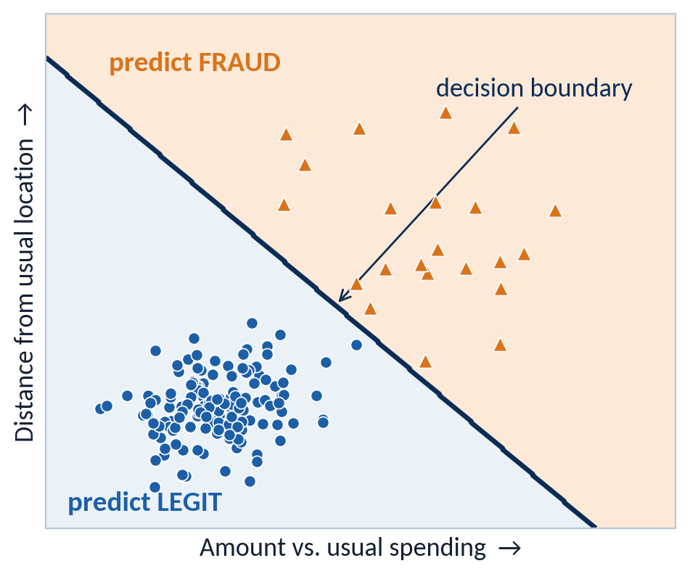
One neuron = logistic regression
You have already met this neuron.
L26 logistic regression
Linear score z
Sigmoid
Threshold
=
L28 artificial neuron
Σ wᵢxᵢ + b
Activation σ
Output > 0.5?
Same math, new names. One neuron draws one straight boundary.
L26’s logistic-regression boundary: one neuron’s z = 0 line.
CS 471 | L28: Neural Networks I
9
Notes:
TIMING: 1.5 min.
INSTRUCTOR: Put the L26 logistic regression pipeline next to the neuron: weighted score z, sigmoid, threshold. They are identical. A single neuron with a sigmoid activation IS logistic regression; the new vocabulary is just "weights," "bias," and "activation."
Consequence: one neuron can only draw one straight boundary (the line where z = 0), exactly like the L26 fraud figure on the right. For Q1 (crash risk), that is fine. For Q2 (CPU too low OR too high), it will not be.
PRECISION NOTE: The source reading calls this a "perceptron." Historically, the perceptron used a hard step function; with a sigmoid it is logistic regression. Both draw a straight boundary.
ASSESSMENT ALIGNMENT: Objectives 1 and 3 (single-neuron boundary is linear); supports Knowledge Check Q1. [Confirm against GR/quiz items when available.]

Slide 10
Practice: engine bearing monitor
Pairs, 2 minutes. Should maintenance pull this engine for inspection?
vibration
2.0
1.2
Σ wᵢxᵢ
?
+ b
−3
z
?
σ
output
?
oil temp
1.5
0.8
Weighted sum Σ wᵢxᵢ = ?
Which input matters more per unit, and how can you tell?
z = ?
P(inspect) = ?
CS 471 | L28: Neural Networks I
10
Notes:
TIMING: 2 min (pairs). If short on time, assign as homework.
ANSWERS (do not show until pairs finish):
Products: 1.2 x 2.0 = 2.4; 0.8 x 1.5 = 1.2. Sum = 3.6. z = 3.6 - 3 = 0.6.
P = 1 / (1 + e^(-0.6)) = 1 / (1 + 0.549) = about 0.65. Flag for inspection.
Per unit of input, vibration matters more (weight 1.2 vs. 0.8).
Follow-up: "What does the bias of -3 mean here?" With normal readings (small inputs), the default is "no inspection needed."
CONTEXT: Inputs are standardized sensor readings (vibration in g, oil temperature on a normalized scale), typical of aircraft engine health monitoring.
ASSESSMENT ALIGNMENT: Objective 1 (independent practice: weighted sum and sigmoid). Original numbers. [Confirm against GR/quiz/homework items when available.]

Slide 11
Feedforward architecture
Neurons arranged in layers; data flows one way, input to output.
Feedforward
Values flow left to right, no loops.
Fully connected
Each neuron takes every value from the layer before.
Depth / width
Number of weight layers / neurons per layer.
Parameters in a 3-4-1 network
(3×4 + 4) + (4×1 + 1) = 21
Input layer
Hidden layer (ReLU)
Output (sigmoid)
CS 471 | L28: Neural Networks I
11
Notes:
TIMING: 2 min (Part 2 total 13 min).
INSTRUCTOR: Stack neurons into layers. The input layer just holds the feature values (no computation). Each hidden-layer neuron takes ALL the previous layer's values as its inputs (fully connected), computes its own weighted sum and activation, and passes its output forward. The output layer produces the prediction. "Feedforward" means no loops: values move strictly left to right.
Vocabulary: depth = number of layers with weights; width = neurons in a layer; "hidden" = not directly observed as input or output.
Parameter count, the quick skill: every connection has a weight and every non-input neuron has a bias. 3-4-1: (3 x 4 weights + 4 biases) + (4 x 1 weights + 1 bias) = 16 + 5 = 21. Modern language models have hundreds of billions.
ASSESSMENT ALIGNMENT: Objective 2 (feedforward architecture vocabulary; parameter counting). [Confirm against GR/quiz items when available.]

Slide 12
Activation functions
ReLU in the hidden layers; sigmoid when the output is a probability.
ReLU
Sigmoid
Output range 0 to ∞. Negative sums become exactly 0. Default for hidden layers.
Output range 0 to 1. Used at the output for a probability.
ReLU(−3.7) = 0
ReLU(2.5) = 2.5
σ(0) = 0.5
CS 471 | L28: Neural Networks I
12
Notes:
TIMING: 2 min.
INSTRUCTOR: ReLU (rectified linear unit): f(z) = max(0, z). Negative sums become exactly 0 (the neuron is "off"); positive sums pass through unchanged. Cheap to compute and the default for hidden layers.
Sigmoid: squashes any z into (0, 1), so it is used at the output when we want a probability. sigma(0) = 0.5.
Chips: ReLU(-3.7) = 0; ReLU(2.5) = 2.5; sigma(0) = 0.5.
Why ReLU's zero matters (Knowledge Check Q4 idea): a neuron with a negative sum sends exactly 0 forward, contributing nothing for that input. Different inputs switch on different subsets of neurons, which is part of how a network represents different patterns. And the kink at 0 is what makes ReLU non-linear (Part 3).
ASSESSMENT ALIGNMENT: Objective 2 (apply ReLU and sigmoid); Knowledge Check Q4. [Confirm against GR/quiz items when available.]

Slide 13
Step 1: hidden neuron 1
Forward propagation computes layer by layer, left to right. Start with h₁.
b = 0
Hidden neuron h₁
weights [1, −2], bias 0
z₁ = 1(3) + (−2)(1) + 0
z₁ = 1
h₁ = ReLU(1) = 1
x₁
3
h₁ ReLU
?
1
1.5
−1
out σ
?
−2
b = 0.5
x₂
1
h₂ ReLU
?
2
1
b = 1
CS 471 | L28: Neural Networks I
13
Notes:
TIMING: 2 min.
INSTRUCTOR: Network: 2 inputs, 2 hidden ReLU neurons, 1 sigmoid output. Weights on the lines (blue positive, orange negative); biases under the nodes. Input x = [3, 1].
Only the edges into h1 are highlighted. h1's weights are 1 (from x1) and -2 (from x2); its bias is 0.
z1 = 1(3) + (-2)(1) + 0 = 1. ReLU(1) = 1. Write 1 in the h1 node.
Emphasize: nothing new. A hidden neuron is exactly the slide 7 calculation with a different activation.
ASSESSMENT ALIGNMENT: Objective 2 (forward propagation, weighted sums with ReLU). Original numbers. [Confirm against GR/quiz/homework items when available.]

Slide 14
Step 2: hidden neuron 2
Same inputs, different weights, a very different result.
b = 0
Hidden neuron h₂
weights [−1, 1], bias 1
z₂ = (−1)(3) + 1(1) + 1
z₂ = −1
h₂ = ReLU(−1) = 0
Switched off for this input.
x₁
3
h₁ ReLU
1
1
1.5
−1
out σ
?
−2
b = 0.5
x₂
1
h₂ ReLU
?
2
1
b = 1
CS 471 | L28: Neural Networks I
14
Notes:
TIMING: 2 min.
INSTRUCTOR: Now h2: weights -1 (from x1) and 1 (from x2), bias 1.
z2 = (-1)(3) + 1(1) + 1 = -1. ReLU(-1) = 0. h2 is "switched off" for this input: it passes nothing forward.
Ask: "Is that a bug?" No. For this input, whatever pattern h2 detects is absent. For other inputs it will switch on (students verify on slide 16).
ASSESSMENT ALIGNMENT: Objective 2; Knowledge Check Q4 (ReLU on a negative weighted sum). Original numbers. [Confirm against GR/quiz/homework items when available.]

Slide 15
Step 3: the output neuron
The hidden values become the output neuron’s inputs.
b = 0
Output neuron
inputs [h₁, h₂] = [1, 0]
z = 1.5(1) + 2(0) + 0.5 = 2
P = σ(2) ≈ 0.88
x₁
3
h₁ ReLU
1
1
1.5
−1
out σ
?
−2
x₂
1
h₂ ReLU
0
2
b = 0.5
1
b = 1
Interpret
Predict
h₂ contributed nothing (0 × 2). The prediction flowed entirely through h₁.
For x = [1, 2], which hidden neuron will fire? Check on the next slide.
CS 471 | L28: Neural Networks I
15
Notes:
TIMING: 2.5 min.
INSTRUCTOR:
COMPUTE: The output neuron's inputs are the hidden VALUES [1, 0], not the original features. Weights [1.5, 2], bias 0.5. z = 1.5(1) + 2(0) + 0.5 = 2. Sigmoid: e^(-2) is about 0.135, so P = 1 / 1.135, about 0.88.
INTERPRET: h2 contributed nothing for this input (0 x 2 = 0), so the prediction came entirely through h1. Different inputs light up different paths through the network.
PREDICT: For x = [1, 2], which hidden neuron fires? Quick look: h1 = 1 - 4 = -3 (off); h2 = -1 + 2 + 1 = 2 (on). The path flips. Students confirm on the next slide.
The whole pass is called forward propagation: compute layer by layer, left to right.
ASSESSMENT ALIGNMENT: Objective 2 (complete a forward pass). Original numbers. [Confirm against GR/quiz/homework items when available.]

Slide 16
Practice: forward pass for x = [1, 2]
Pairs, 3 minutes. Same network, new input.
b = 0
h₁ = ?
x₁
1
h₁ ReLU
?
1
h₂ = ?
1.5
−1
out σ
?
z (output) = ?
−2
b = 0.5
P = ?
x₂
2
h₂ ReLU
?
2
1
Which path carried the signal this time?
b = 1
CS 471 | L28: Neural Networks I
16
Notes:
TIMING: 2.5 min (pairs). If short on time, assign as homework.
ANSWERS (do not show until pairs finish):
h1: z = 1(1) + (-2)(2) + 0 = -3, so h1 = 0 (off).
h2: z = (-1)(1) + 1(2) + 1 = 2, so h2 = 2 (on).
Output: z = 1.5(0) + 2(2) + 0.5 = 4.5; P = sigma(4.5), about 0.99.
The active path flipped: this time the prediction flowed entirely through h2.
WATCH FOR: Students feeding the raw inputs [1, 2] into the output neuron instead of the hidden values [0, 2].
ASSESSMENT ALIGNMENT: Objective 2 (independent forward propagation). Original numbers. [Confirm against GR/quiz/homework items when available.]

Slide 17
The band problem
Alert if CPU is too low or too high. Healthy is in the middle.
hung service
healthy
overload
0
20
40
60
80
100
CPU load (%)
one neuron’s threshold
One neuron = one threshold
L26 callback
It can flag “above 82%” or “below 18%,” but never both. Some alerts always land on the wrong side.
The kernel slide fixed this shape by hand-adding x². Can a network build its own fix?
A straight boundary cannot carve out a middle band.
CS 471 | L28: Neural Networks I
17
Notes:
TIMING: 2 min (Part 3 total 12 min).
INSTRUCTOR: Return to Q2. Plot CPU load on a number line: alerts (orange) at both ends, healthy (blue) in the middle. A single neuron computes z = w x cpu + b; its output crosses 0.5 at ONE cpu value, so it can separate "left of a point" from "right of a point." Whichever threshold you choose, one group of alerts ends up on the wrong side.
Callback: L26's kernel slide had exactly this shape (fraud at both extremes of one feature), and we fixed it by hand-adding x-squared. Today the network will build its own fix out of two hidden ReLU neurons.
ASSESSMENT ALIGNMENT: Objective 3 (limits of a single neuron; need for hidden layers). [Confirm against GR/quiz items when available.]

Slide 18
Two ReLU neurons become feature detectors
One hidden neuron watches for “too low,” the other for “too high.”
h₁ = ReLU(20 − cpu) h₂ = ReLU(cpu − 80)
z = 0.5h₁ + 0.5h₂ − 2
b = 20
h₁ ReLU
low?
−1
0.5
input
cpu
out σ
alert
1
0.5
b = −2
h₂ ReLU
high?
b = −80
CS 471 | L28: Neural Networks I
18
Notes:
TIMING: 2.5 min.
INSTRUCTOR: A 1-2-1 network. h1 = ReLU(20 - cpu): positive only when CPU is below 20, and larger the further below it goes. That is a "too low" detector. h2 = ReLU(cpu - 80): positive only above 80, a "too high" detector. The output adds them: z = 0.5 h1 + 0.5 h2 - 2, then sigmoid.
Charts on the right: each ReLU draws a hinge (flat, then a ramp). Adding two hinges and squashing gives a U-shaped alert probability: high at both ends, low in the middle. That shape was impossible for a single neuron.
Key idea: nobody told the network "too low" and "too high" exist. In a trained network, hidden neurons discover useful intermediate features like these from data. Today we hand-set the weights so we can read them.
ASSESSMENT ALIGNMENT: Objective 3 (how hidden ReLU neurons create non-linear boundaries). [Confirm against GR/quiz items when available.]

Slide 19
Worked example: the band network
Compute → Interpret → Predict at three CPU readings.
CPU | h₁ = ReLU(20 − cpu) | h₂ = ReLU(cpu − 80) | z = 0.5h₁ + 0.5h₂ − 2 | P(alert)
10 | 10 | 0 | 3 | 0.95
50 | 0 | 0 | −2 | 0.12
85 | 0 | 5 | 0.5 | 0.62
Interpret
Predict
The hidden neurons built two new features from one raw input: “how far below 20” and “how far above 80.”
Where does P cross 0.5? Solve z = 0 on each side. What healthy band did the network carve out?
Two hinges plus a squash make a shape no single neuron can draw.
CS 471 | L28: Neural Networks I
19
Notes:
TIMING: 3 min.
INSTRUCTOR:
COMPUTE row by row. CPU 10: h1 = ReLU(10) = 10, h2 = ReLU(-70) = 0, z = 5 - 2 = 3, P = sigma(3), about 0.95: alert. CPU 50: both detectors are 0, z = -2, P about 0.12: healthy. CPU 85: h1 = 0, h2 = 5, z = 2.5 - 2 = 0.5, P about 0.62: alert.
INTERPRET: The hidden neurons turned one raw feature into two useful ones, "how far below 20" and "how far above 80." We would otherwise have engineered those by hand (like x-squared in L26).
PREDICT: Where does P cross 0.5? When z = 0, so 0.5 h1 = 2 (h1 = 4, CPU = 16) or 0.5 h2 = 2 (h2 = 4, CPU = 84). The network carved out a healthy band from 16 to 84. Bonus: CPU 95 gives h2 = 15, z = 5.5, P about 0.996.
ASSESSMENT ALIGNMENT: Objectives 2 and 3 (forward propagation through ReLU; interpret the non-linear boundary). Original numbers. [Confirm against GR/quiz/homework items when available.]

Slide 20
Why linear layers collapse
A line of a line is still a line.
Linear stack
h = 2x + 1
y = 3h − 4 = 3(2x + 1) − 4
y = 6x − 1: still one straight line
With a ReLU in between
y = 3 · ReLU(2x + 1) − 4
Flat at −4 until x = −0.5, then rises: it bends
Five linear layers equal one neuron. Non-linearity is what makes depth worth it.
CS 471 | L28: Neural Networks I
20
Notes:
TIMING: 2.5 min.
INSTRUCTOR:
COMPUTE: Two linear "neurons" in a row: h = 2x + 1, then y = 3h - 4. Substitute: y = 3(2x + 1) - 4 = 6x - 1. The two-layer network is exactly one linear neuron with weight 6 and bias -1. Stack 5 or 50 linear layers and the same algebra collapses them into one (Knowledge Check Q1: the boundary is still a single straight line, no better than one perceptron).
CONTRAST: Put a ReLU between them: y = 3 ReLU(2x + 1) - 4. For x below -0.5 the ReLU outputs 0, so y is flat at -4; above -0.5 it follows 6x - 1. The line bends at x = -0.5. The chart shows both.
ANALOGY (from the reading): stacking transparent colored lenses gives one blended color. Non-linearity is what lets layers add something new.
ASSESSMENT ALIGNMENT: Objective 3; Knowledge Check Q1. [Confirm against GR/quiz items when available.]

Slide 21
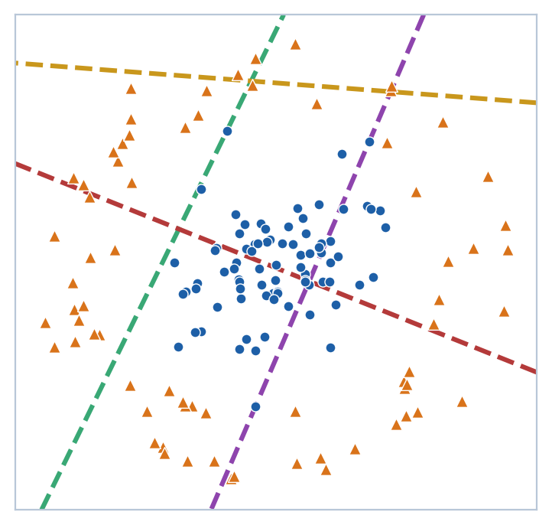
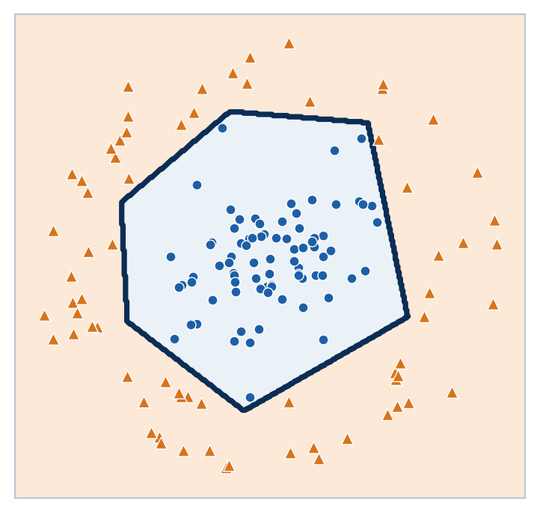
Bending in 2D
Each hidden ReLU neuron adds one fold; together they wrap a cluster.
Abstraction
Images: edges → shapes → objects. Each layer builds on the last.
Caution
More folds can overfit (L26). The goal is generalization.
Each dashed line: one hidden neuron switching on
Output: the folds combine into a closed region
Straight pieces, bent together, make curved boundaries.
CS 471 | L28: Neural Networks I
21
Notes:
TIMING: 2 min.
INSTRUCTOR: This is a real network, trained (not hand-set) on two-class data where one class sits in the middle and the other surrounds it: a 2D version of the band problem. It has 5 hidden ReLU neurons.
Left: each dashed line is one hidden neuron's z = 0 line, where that neuron switches on. Each one is still a straight line. Right: the output combines those half-planes into a closed, many-sided region around the middle cluster. No single straight boundary, and no model in the L26 gallery except QDA or a kernel SVM, could do this.
Abstraction (verbal): in image recognition, early layers detect edges, later layers combine edges into shapes, and later still into objects. Hidden layers build features out of features.
CAUTION: More neurons can wrap the data ever more tightly, which is the overfitting risk from L26. Wrapping training data "perfectly" is not the goal; generalization is.
ASSESSMENT ALIGNMENT: Objective 3 (hidden layers create non-linear boundaries). [Confirm against GR/quiz items when available.]

Slide 22
One network, several outputs
Shared hidden layers feed more than one prediction.
Why share?
distance
Price and ETA depend on the same hidden facts (how slow the trip is, demand). Learn them once; keep both predictions consistent.
price
traffic
Linear outputs
ETA
Dollars and minutes are continuous numbers, so no sigmoid: the output is just z.
weather
Y = [ y_{price}, y_{ETA} ]
Inputs
Shared hidden layer
Two outputs
CS 471 | L28: Neural Networks I
22
Notes:
TIMING: 2.5 min (Part 4 total 6 min).
INSTRUCTOR: A ride-share app needs a price quote AND an arrival time for the same trip. Two separate models would each learn, on their own, the same underlying facts (how slow this trip will be, how much demand there is). A single network with shared hidden layers learns those intermediate features once, and each output neuron reads them its own way.
Benefits: the two predictions stay consistent (the same traffic estimate drives both), and features learned from one task help the other, which is useful when data is limited.
Outputs here are continuous numbers (dollars, minutes), so the output neurons use a LINEAR activation: no sigmoid, which would squash them into 0 to 1.
MILITARY/ENGINEERING PARALLEL (Knowledge Check Q3): fuel consumption and time-on-target for a strike package both depend on the same drag, weight, and wind conditions; a shared-trunk network keeps them consistent. Satellite operations: battery temperature and power draw from the same telemetry.
ASSESSMENT ALIGNMENT: Objective 3 (multiple outputs, shared representation); Knowledge Check Q3. [Confirm against GR/quiz items when available.]

Slide 23
Worked example: two outputs
Compute → Predict: one set of hidden values, two predictions.
shared hidden values
b = 2
Compute
h₁
2
price
$12
Price = 3(2) + 4(1) + 2 = $12
ETA = 5(2) + 2(1) + 1 = 13 min
3
5
Predict
4
Traffic spike: h₂ rises from 1 to 3.
Price = $20, ETA = 17 min
h₂
1
ETA
13 min
2
b = 1
Both move together because both read h₂.
CS 471 | L28: Neural Networks I
23
Notes:
TIMING: 2.5 min.
INSTRUCTOR: Suppose the shared hidden layer (two neurons here for simplicity) produced h = [2, 1] for this trip. Each output neuron has its own weights and bias, with linear activation.
COMPUTE: Price = 3(2) + 4(1) + 2 = 12 dollars. ETA = 5(2) + 2(1) + 1 = 13 minutes.
PREDICT: A traffic spike raises h2 from 1 to 3 (h2 behaves like a "congestion" feature). Price = 6 + 12 + 2 = 20 dollars; ETA = 10 + 6 + 1 = 17 minutes. Both rise together because both read the same h2. With two separate models, nothing would guarantee that consistency.
ASSESSMENT ALIGNMENT: Objectives 2 and 3 (forward pass to a vector output). Original numbers. [Confirm against GR/quiz/homework items when available.]

Slide 24
From neuron to network
Four ideas, and a new row for the model comparison table.
Weighted sum
z = Σ wᵢxᵢ + b
Activation
ReLU hidden, σ output
Layer
many neurons, same inputs
Network
layers feed forward
Model | Key assumption | Boundary | Bias / variance lean
Logistic regression (= 1 neuron) | Log-odds linear in the features | Line | Higher bias, low variance
Naive Bayes | Features independent given the class | Linear in word counts | High bias, low variance
Neural network (new) | Learns its own features | Almost any shape, given enough neurons | Low bias, high variance; needs lots of data
Next lesson: where the weights come from.
CS 471 | L28: Neural Networks I
24
Notes:
TIMING: 1.5 min (synthesis total 5 min).
INSTRUCTOR: Recap the chain: weighted sum, activation, layer, network. Then add neural networks to the running comparison table from L26 and L27. A single neuron is logistic regression. A network with hidden ReLU layers assumes no particular boundary shape; it learns its own features, and with enough neurons it can approximate essentially any shape (backup B3). The price is the L26 tradeoff: low bias, high variance, lots of data needed, and many parameters to learn.
Tee up next lesson: today every weight was given. Next, how a network learns its weights from data.
ASSESSMENT ALIGNMENT: Objectives 1-3 synthesis; links to L26 Objective 3. [Confirm against GR/quiz/notebook items when available.]

Slide 25
Diagnose the claim
Correct or incorrect? Be ready to fix the incorrect ones.
Adding more linear layers makes a network more flexible.
1
Correct
Incorrect
ReLU passes negative inputs through, just smaller.
2
Correct
Incorrect
One neuron with a sigmoid activation is logistic regression.
3
Correct
Incorrect
The bias gives a neuron a default leaning when all inputs are 0.
4
Correct
Incorrect
A price-prediction output should use a sigmoid activation.
5
Correct
Incorrect
CS 471 | L28: Neural Networks I
25
Notes:
TIMING: 1.5 min. Pairs vote, then discuss.
ANSWERS:
1. Incorrect. Linear layers collapse into one linear layer; only non-linear activations add flexibility.
2. Incorrect. ReLU outputs exactly 0 for any negative weighted sum.
3. Correct. Same formula as L26: weighted sum then sigmoid.
4. Correct. The bias is the neuron's default leaning (its z when every input is 0).
5. Incorrect. Adding a sigmoid to a dollar-value output squashes it into 0 to 1; continuous outputs use a linear activation.
WATCH FOR: Claim 1 is the most commonly missed.
ASSESSMENT ALIGNMENT: Objectives 1-3 (misconception check). [Confirm against GR/quiz items when available.]

Slide 26
Exit ticket: intrusion detector
Put the whole lesson together.
A login-monitoring neuron uses failed attempts in the last hour (x₁ = 4) and a new-country flag (x₂ = 1), with weights 0.5 and 1.5 and bias −4. Its output is P(intrusion).
1
2
3
Compute z and P(intrusion). Does it alert at 0.5?
A hidden neuron’s weighted sum is −2.6. What does ReLU pass on, and why does it matter?
If every activation in a 4-layer network were linear, what shape could its boundary be?
A neuron is a weighted vote plus a squash. Non-linear layers let networks bend.
CS 471 | L28: Neural Networks I
26
Notes:
TIMING: 2 min (collect on paper or in Blackboard).
STRONG ANSWERS:
1. z = 0.5(4) + 1.5(1) - 4 = 2 + 1.5 - 4 = -0.5. P = 1 / (1 + e^0.5) = 1 / 2.649, about 0.38. Below 0.5: no alert (but close).
2. ReLU(-2.6) = 0. The neuron passes nothing forward for this login; it is switched off. This zeroing is what makes ReLU non-linear, so the network can bend its boundary.
3. Every layer would collapse into one linear function, so the whole network's boundary would be a single straight line, no better than one neuron.
CLOSE: Restate the central claim on the slide.
ASSESSMENT ALIGNMENT: Objectives 1-3 integrated (performance target). [Map to GR/quiz/homework items when available.]

Slide 27
Backup B1: layers as matrix multiplication
The slide 13-15 network in two lines of linear algebra.
h = ReLU(W₁x + b₁) ŷ = σ(W₂h + b₂)
Step | Values
W₁ = [[1, −2], [−1, 1]], x = [3, 1] | W₁x = [1, −2]
Add b₁ = [0, 1] | [1, −1]
Apply ReLU element-wise | h = [1, 0]
W₂ = [1.5, 2], b₂ = 0.5 | z = 2, ŷ = σ(2) ≈ 0.88
A layer is one matrix multiply: why GPUs power deep learning.
CS 471 | L28: Neural Networks I
27
Notes:
USE: For students who ask how real code computes a layer, or before notebook work with NumPy, PyTorch, or Keras.
EXPLAIN: Stack each hidden neuron's weights as a row of a matrix W1. Then the whole hidden layer is h = ReLU(W1 x + b1): one matrix-vector product, one vector add, one element-wise ReLU. The output is sigma(W2 h + b2). This is why GPUs, built for fast matrix multiplication, made deep learning practical.
Check: W1 x = [1(3) - 2(1), -1(3) + 1(1)] = [1, -2]; + b1 [0, 1] = [1, -1]; ReLU gives [1, 0]; W2 h + b2 = 1.5 + 0 + 0.5 = 2; sigma(2), about 0.88. Same as slide 15.
ASSESSMENT ALIGNMENT: Enrichment; likely relevant to notebook homework. [Confirm.]

Slide 28
Backup B2: other activation functions
Beyond ReLU and sigmoid.
Activation | Formula | Output range | Typical use
ReLU | max(0, z) | 0 to ∞ | Hidden layers (default)
Sigmoid | 1 / (1 + e^(−z)) | 0 to 1 | Binary output probability
tanh | (e^z − e^(−z)) / (e^z + e^(−z)) | −1 to 1 | Older and recurrent networks
Leaky ReLU | max(0.01z, z) | −∞ to ∞ | Hidden layers; avoids dead neurons
Softmax | e^(zᵢ) / Σ e^(zⱼ) | 0 to 1, sums to 1 | Multiclass output
Linear | z | −∞ to ∞ | Continuous outputs (price, time)
CS 471 | L28: Neural Networks I
28
Notes:
USE: If students ask what else exists, or before multiclass problems.
EXPLAIN: tanh is a zero-centered sigmoid, output -1 to 1; common in older networks and recurrent models. Leaky ReLU lets a small fraction of negative sums through (e.g., 0.01z), which keeps neurons from getting permanently stuck at 0 ("dead ReLU"). Softmax turns a vector of output scores into probabilities that sum to 1 across several classes; it is the multiclass generalization of the sigmoid.
Linear output: used for continuous predictions like the price and ETA example.
ASSESSMENT ALIGNMENT: Enrichment. [Confirm.]

Slide 29
Backup B3: enough hinges trace any curve
Universal approximation, in one picture.
The recipe
f(x) = 4 − 3(x + 2) + 2·ReLU(x + 1) + 2·ReLU(x) + 2·ReLU(x − 1)
The fine print
Such weights exist; training may not find them, and a close fit to training data can still fail to generalize.
CS 471 | L28: Neural Networks I
29
Notes:
USE: For students asking why networks can model "almost any shape."
EXPLAIN: Each ReLU neuron contributes one hinge (a place where the slope changes). Adding enough hinges can approximate any reasonable curve as closely as you like. Here, three ReLU neurons plus a straight line trace x-squared, the same feature we hand-built for the L26 kernel slide:
f(x) = 4 - 3(x + 2) + 2 ReLU(x + 1) + 2 ReLU(x) + 2 ReLU(x - 1), which matches x-squared exactly at x = -2, -1, 0, 1, 2 and is close in between. More neurons, finer fit.
Formal result: the universal approximation theorem (Cybenko 1989; Hornik 1991). It guarantees such weights exist, not that training will find them or that the fit will generalize.
ASSESSMENT ALIGNMENT: Enrichment. [Confirm.]

